Slide 1
Odd and Even Functions with their Fourier Series, Half range Expansion of Fourier Series.
Differential Equations Presentation

Slide 2
Group Members
SayeedTauheedShah (14143)
Introduction to Odd and Even Functions
TaimoorUl Islam (14031)
Introduction to Fourier Series and Fourier Transform
Hamad Khan (13654)
ShayanAmir (13664)
Hamad Ali (14109)
Amar (11637)
Fourier Series for Odd and Even Functions
Half-range expansion of Fourier Series
Comparison and Applications
Practical Examples
Abdul Muqeet Paracha ()
Conclusion

Slide 3
Introduction to Odd and Even Functions
Sayeed Tauheed Shah (14143)

Slide 4
Definitions
Even Functions
Odd Functions
A function f(x) is called even if, for all values of x in the domain of the function, the following condition holds
f(−x)=f(x)
Example: f(x) = x^2
A function f(x) is called odd if, for all values of x in the domain of the function, the following condition holds
f(−x)= -f(x)
Example: f(x) = x^3

Slide 5
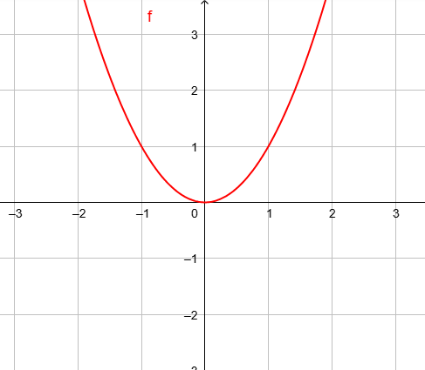
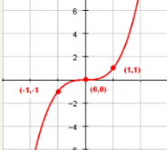
Graphical Representations
Even Functions
Odd Functions

Slide 6
Key Properties
Sum of Even Functions: The sum of two even functions is even.
Sum of Odd Functions: The sum of two odd functions is odd.
Sum of Even and Odd Functions: The sum of an even and an odd function is neither even nor odd in general.

Slide 7
Introduction to Fourier Series and Fourier Transform
Taimoor Ul Islam (14031)

Slide 8
Flow
Problem
Background
Fourier Series
Complex Fourier Series
Fourier Transform
Solve the Problem

Slide 9
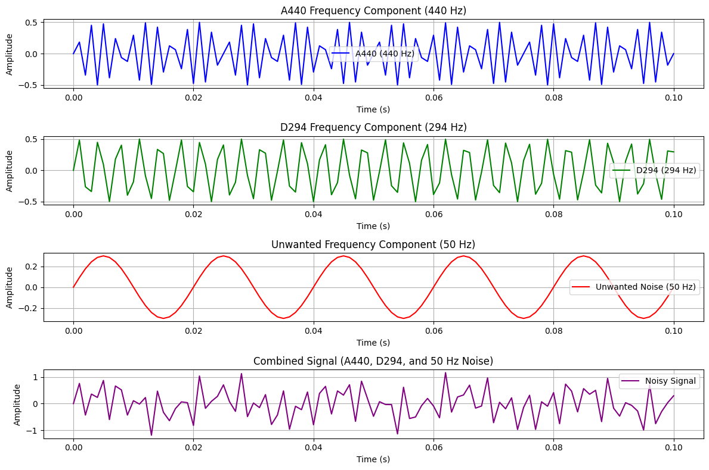
The Problem

Slide 10

Background
The Fourier series was introduced by Joseph Fourier in his work on the theory of heat
He published his seminal work, "Théorie analytique de la chaleur" (The Analytical Theory of Heat), in 1822.
How can the distribution of heat in a rod or a body be mathematically represented and predicted over time?

Slide 11
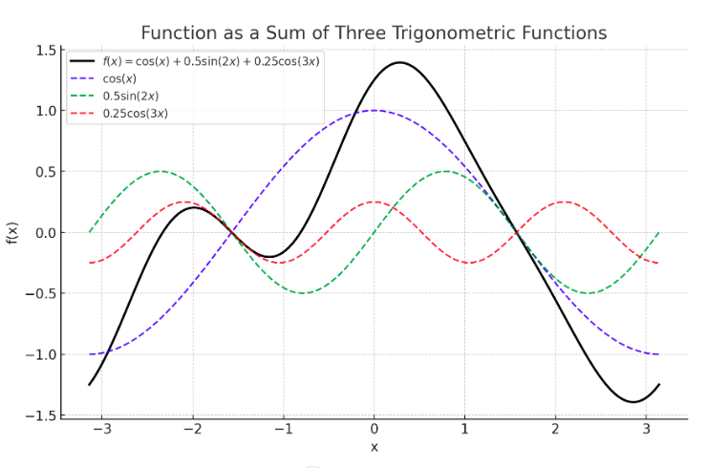
Fourier Series

Slide 12


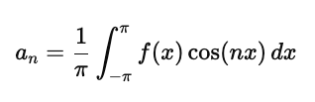
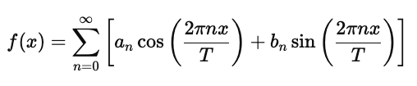


Mathematical Formulation
Fourier series when x is period on domain [−π,π]
Fourier series when x is periodon domain [0,L]

Slide 13




Complex Fouries Series
Fourier Series for real valued function
Euler’s Formula
Fourier Series for complex valued function
Visualization Links
https://bilimneguzellan.net/en/purrier-series-meow-and-making-images-speak/
https://betterexplained.com/articles/an-interactive-guide-to-the-fourier-transform/
https://www.myfourierepicycles.com/

Slide 14


Fourier Transform
Fourier Series for real valued function
Fourier Transform
Inverse Fourier Transform

Slide 15
Solution
Time Domain Signal
Fourier transform
Frequency Domain Signal
Identify and remove unwanted frequency
Inverse Fourier Transform

Slide 16
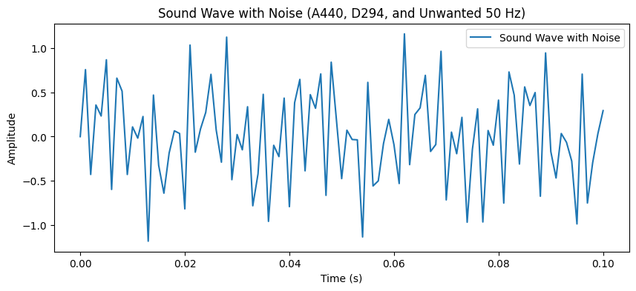
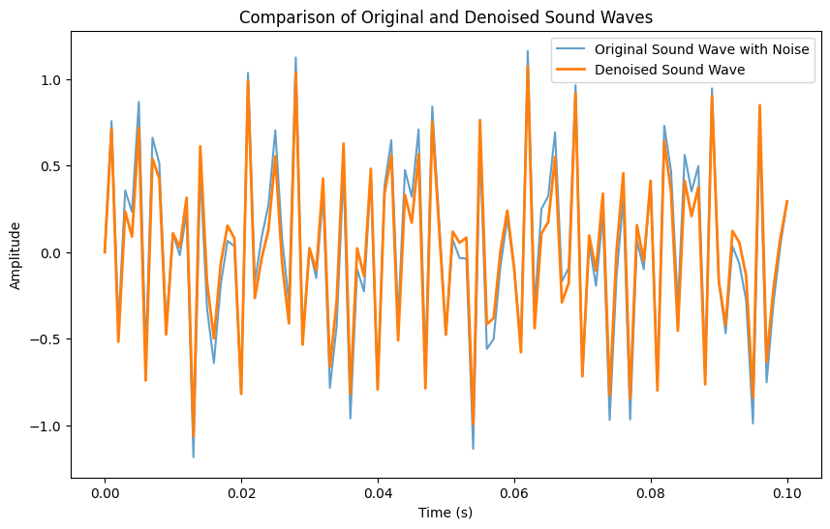
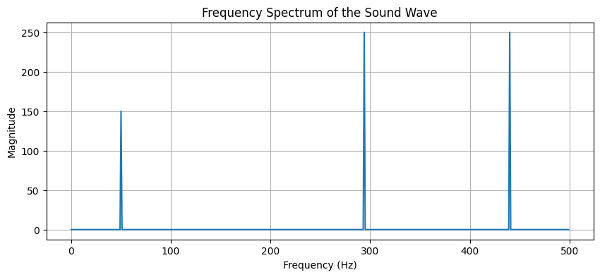
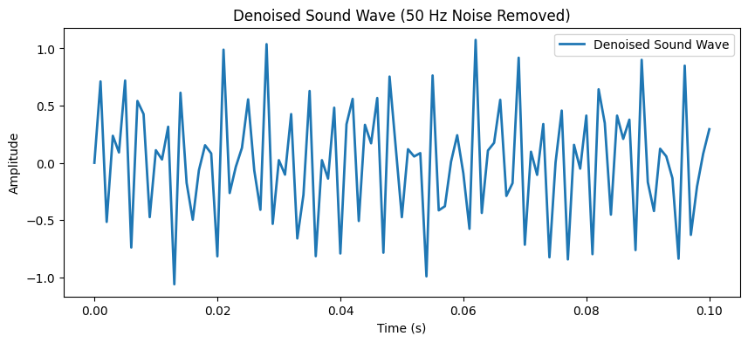
Continue..
Notebook Link: https://colab.research.google.com/drive/14vH6ITtBYKRRm6fDnaW2QFWkdlw9HvDG?usp=sharing

Slide 17
Fourier Series for Odd and Even Functions
Hamad Khan (13654)

Slide 18
Formula Simplification
Fourier Series for Odd and Even Functions Simplification of Fourier series for odd functions (sine series).
Simplification of Fourier series for even functions (cosine series).

Slide 19
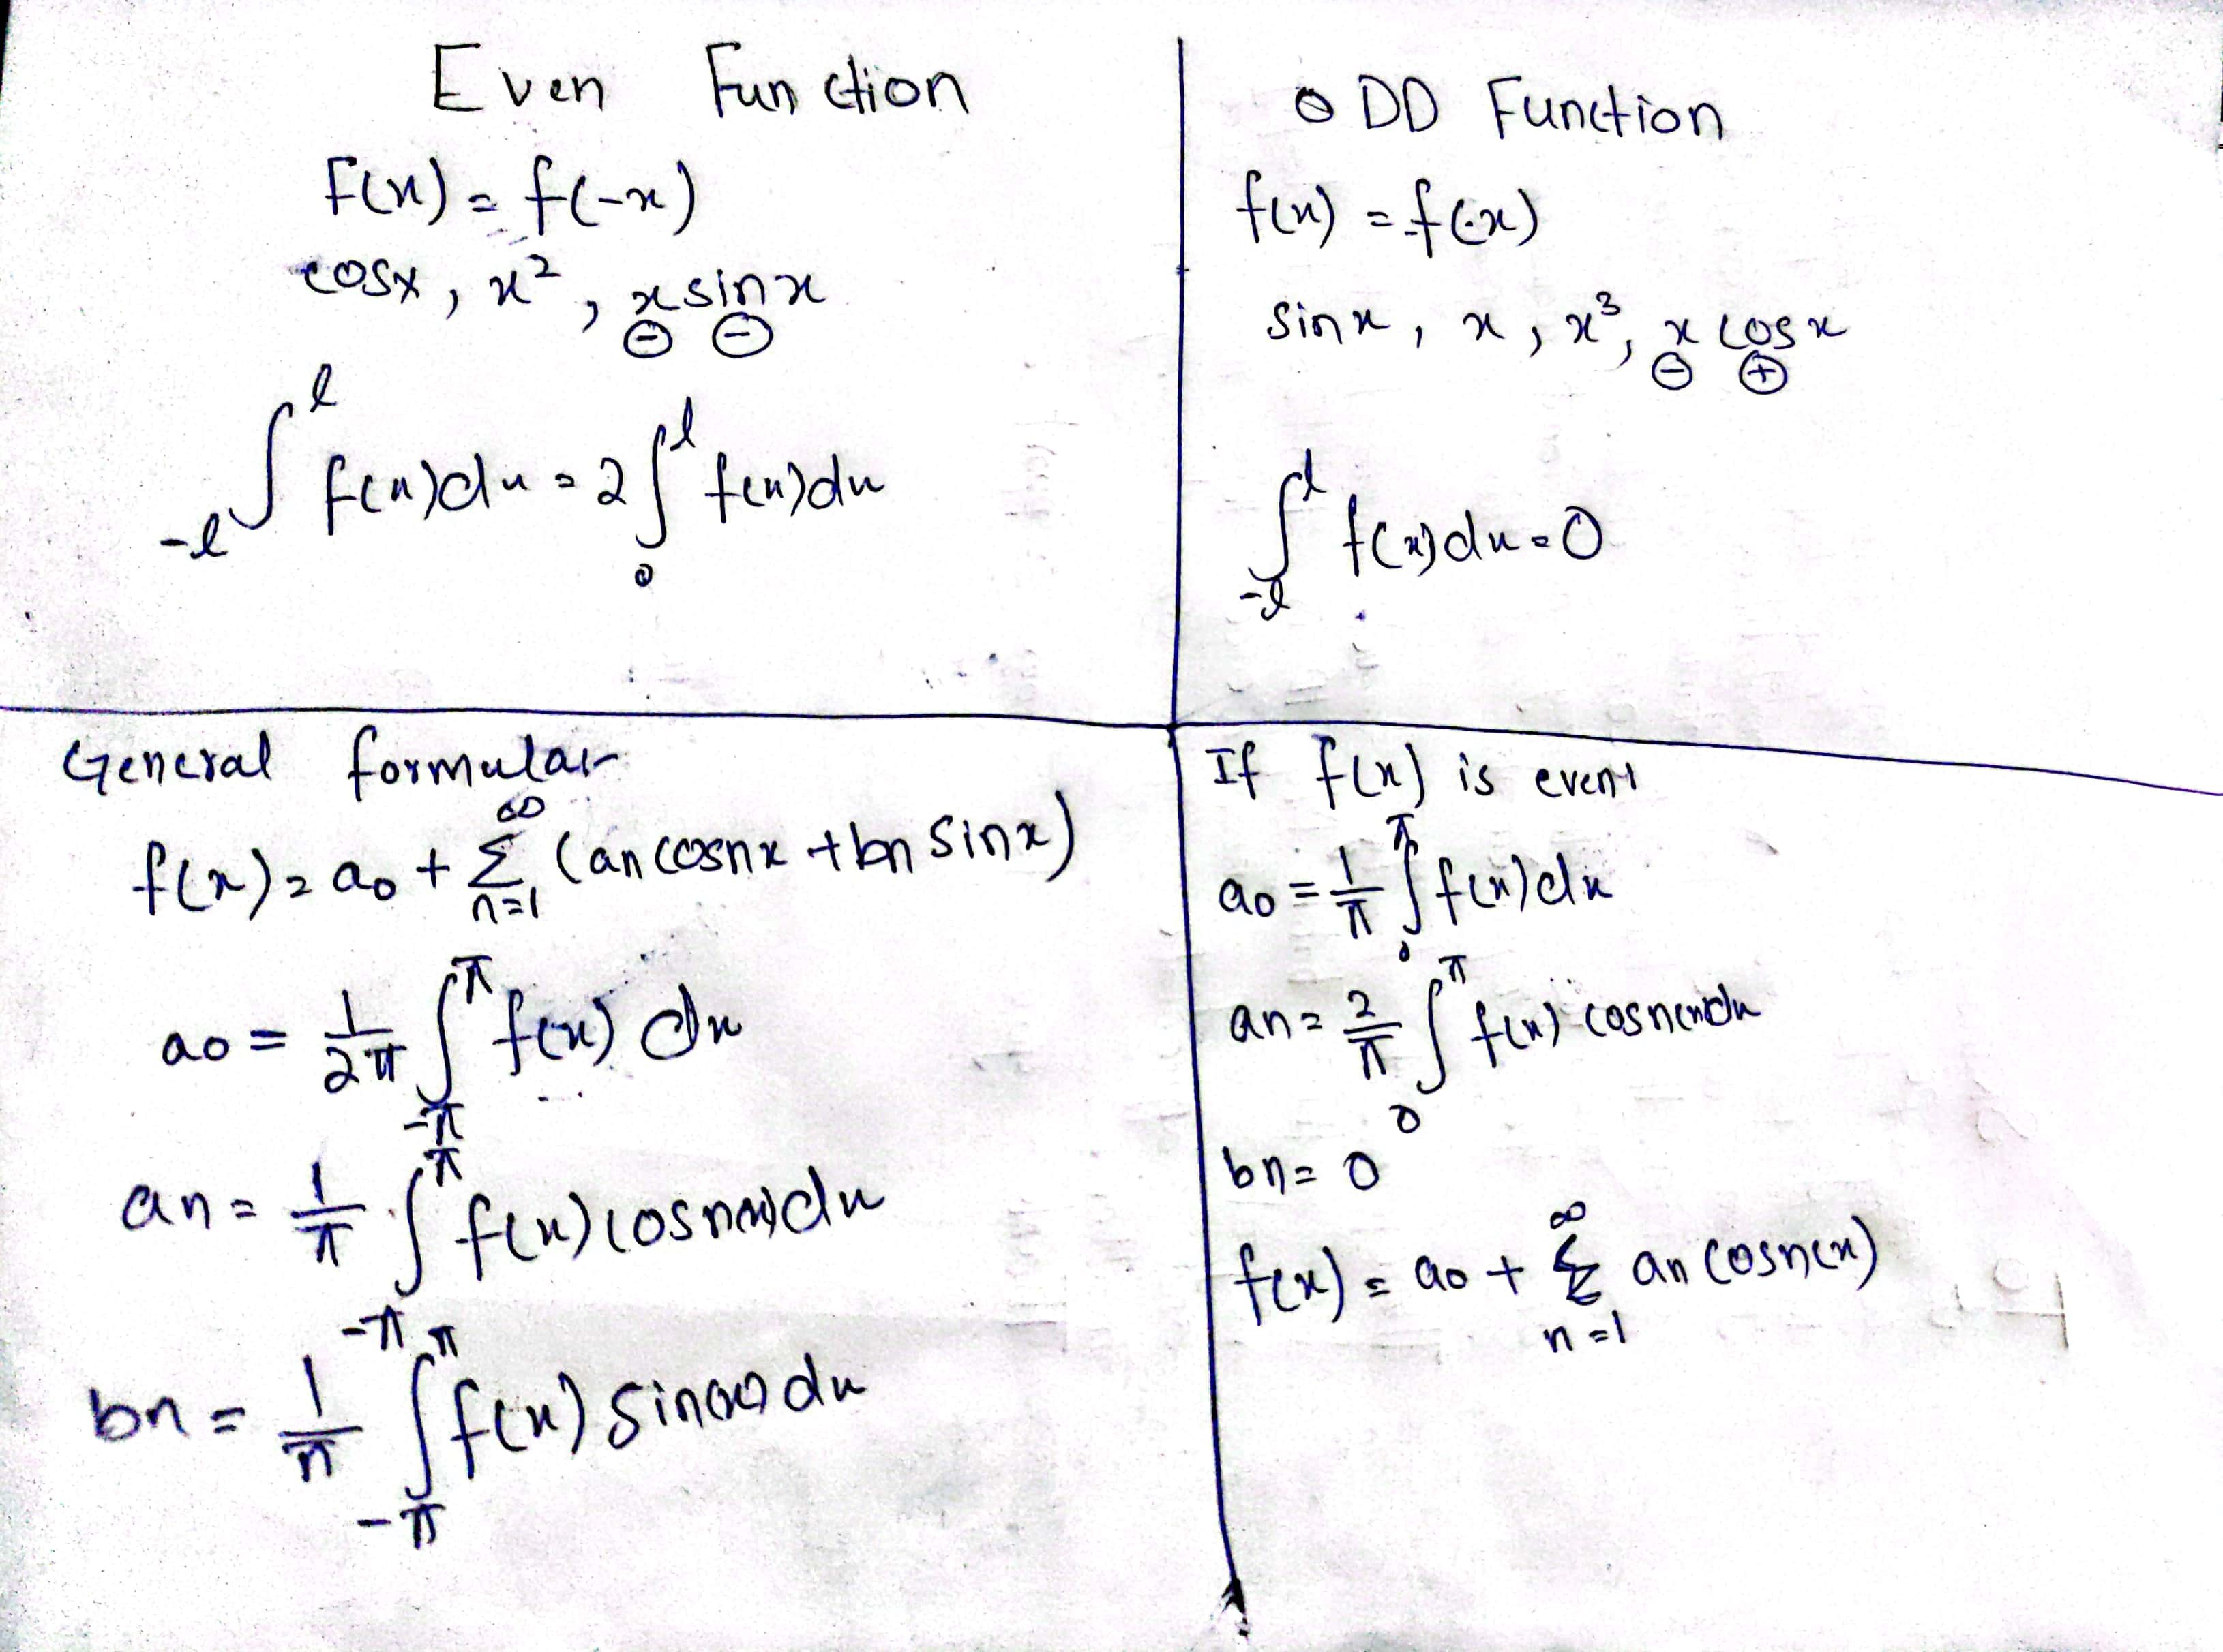
Formula Derivation

Slide 20
Half-range expansion of Fourier Series
Shayan Amir (13664)

Slide 21
What is Half-Range Expansion?
The Half-Range Expansion is used to represent a non-periodic function over a finite interval using Fourier series.
We apply it when the function is defined only over a limited range.
Normally, Fourier series assumes that the function repeats indefinitely. In half-range expansion, we modify the Fourier series so that it only represents the function over a half interval.

Slide 22
Significance:
Representation of Non-Periodic Functions: Half-range expansion allows us to represent functions that are not periodic but defined on a specific interval (like [0,𝐿][0,L]).
Simplified Calculations: Instead of working with full-period functions, we can break down complex problems into simpler parts.

Slide 23
Applications of Half-Range Expansion
Signal Processing: When signals are non-periodic and confined to a limited range, half-range expansion is useful.
Heat Transfer Problems: In cases like a heated bar or wire, the temperature distribution is non-periodic but occurs within a limited range.
Mechanical Vibrations: Analyzing vibrations within a finite interval rather than periodic motion.
Electrical Engineering: Representing currents or voltages that are non-repetitive but occur within a certain time frame.

Slide 24


Formulas for Half-Range Expansion
Half-Range Sine Series (when the function is odd):
For a function f(x) defined on [0,L], the Fourier sine series is:
Where,

Slide 25


Formulas for Half-Range Expansion:
If 𝑓(𝑥)f(x) is an even function, the Fourier cosine series is used:
Where,

Slide 26
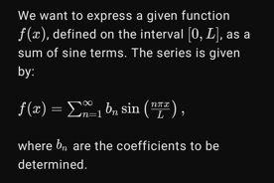
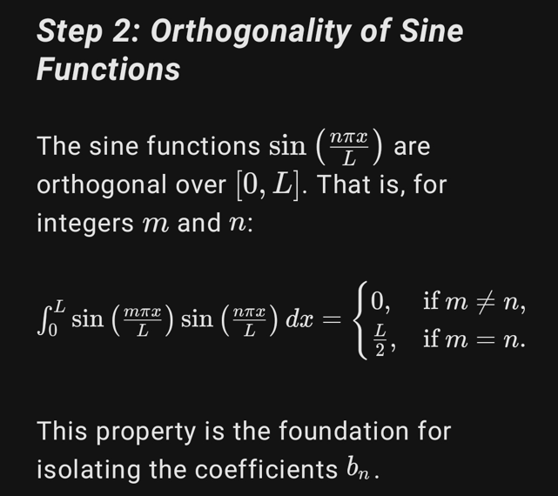
Derivation: Half-Range Sine Series

Slide 27
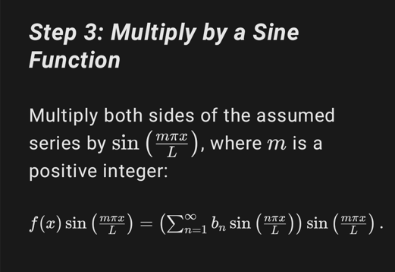
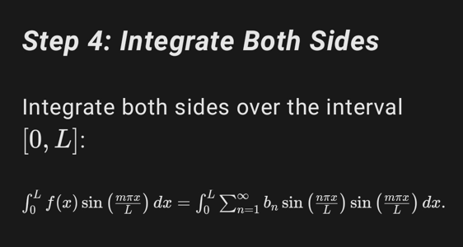
Derivation: Half-Range Sine Series

Slide 28
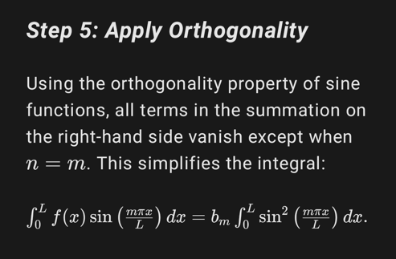
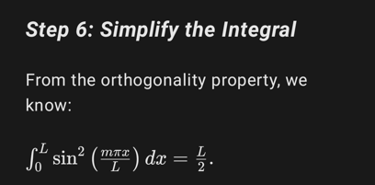
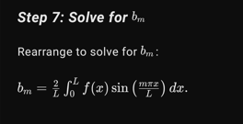
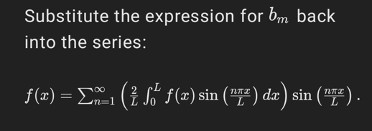
Derivation: Half-Range Sine Series

Slide 29
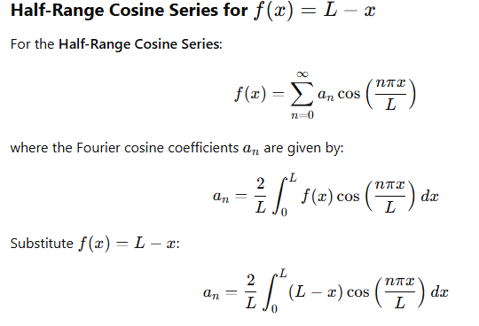
Derivation: Half-Range cosine Series

Slide 30
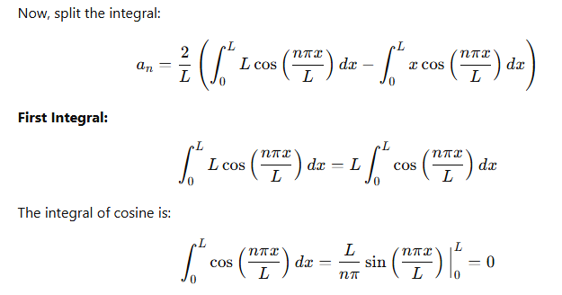
Derivation: Half-Range cosine Series

Slide 31
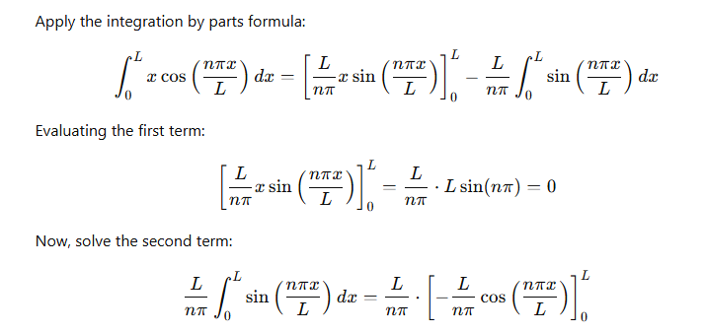
Derivation: Half-Range cosine Series

Slide 32
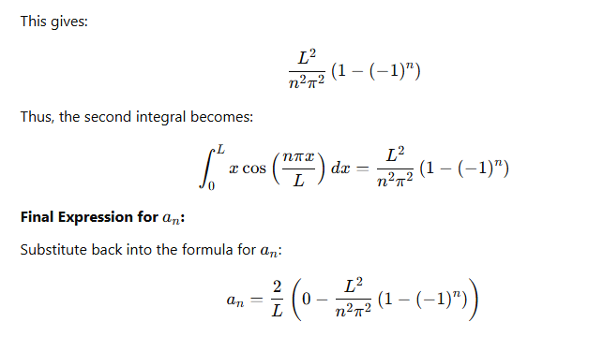
Derivation: Half-Range cosine Series

Slide 33
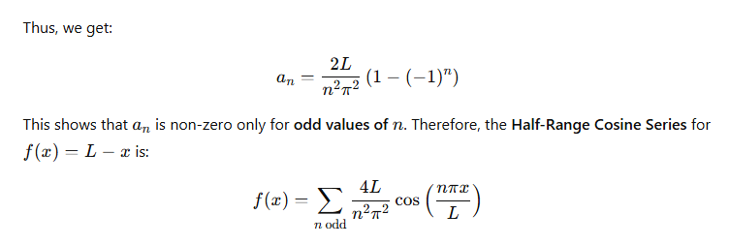
Derivation: Half-Range cosine Series

Slide 34
Comparison and Applications
Hamad Ali (14109)

Slide 35
1. Comparison
Definition:
Full Fourier Series: Represents periodic functions using both sine and cosine terms (or exponential form).
Half Fourier Series: Represents periodic functions only in a half-range (e.g., sine-only or cosine-only expansion).
Range of Application:
Full Fourier Series: Defined over a complete period [−L,L].
Half Fourier Series: Defined over a half-period [0,L], focusing on specific symmetry properties.

Slide 36
1.2 Comparison
Symmetry:
Full Fourier Series: Useful for functions with no specific symmetry or mixed symmetry.
Half Fourier Series: Best for functions with even or odd symmetry.
Terms Included:
Full Fourier Series: Both sine (sin) and cosine (cos) terms.
Half Fourier Series:
Even Symmetry: Only cosine terms.
Odd Symmetry: Only sine terms.

Slide 37
1.1 Full-Range Fourier Series Formula
Formula:
f(x) = a₀ + Σ [aₙ cos(nπx/L) + bₙ sin(nπx/L)]
Coefficients:
a₀ = (1/2L) ∫[−L, L] f(x) dx
aₙ = (1/L) ∫[−L, L] f(x) cos(nπx/L) dx
bₙ = (1/L) ∫[−L, L] f(x) sin(nπx/L) dx

Slide 38
1.2 Half-Range Fourier Series Formulas
Half-Range Cosine Series:
f(x) = (a₀/2) + Σ [aₙ cos(nπx/L)]
aₙ = (2/L) ∫[0, L] f(x) cos(nπx/L) dx
Half-Range Sine Series:
f(x) = Σ [bₙ sin(nπx/L)]
bₙ = (2/L) ∫[0, L] f(x) sin(nπx/L) dx

Slide 39
2. Key Differences: Full-Range vs Half-Range
- Full-Range:
* Defined over symmetric intervals (e.g., [−L, L]).
* Requires sine and cosine terms.
- Half-Range:
* Defined over one-sided intervals (e.g., [0, L]).
* Exploits function symmetry (even or odd).

Slide 40
3.1 Applications full Fourier Series
Full Fourier Series Applications:
General-purpose modeling of periodic signals, such as electrical signals and sound waves.
Analysis of vibrations in mechanical systems.
Engineering applications: signal processing and communications.

Slide 41
3.2 Applications of Half Fourier Series
Half Fourier Series Applications:
Heat conduction problems over a semi-infinite domain (e.g., metal rod heated from one end).
Structural analysis of beams with specific boundary conditions (e.g., clamped/free).
Wave equation solutions with boundary constraints.

Slide 42
Summary of Applications
Type | Key Application | Example
Full range fourier Series | General Periodic Functions | Electrical Circuits, Sound Wave Analysis
Half range Sine Series | Problems with Odd symmetry | Heat Transfer, String Vibrations, Fluid Dynamics
Half range Cosine Series | Problems with even symmetry | Signal Processing, Heat Distribution, Optics

Slide 43
Practical Examples
Amar (11637)

Slide 44
Odd and Even Functions with their Fourier Series, Half range Expansion of Fourier Series
(11637) Ammar UD Din

Slide 45
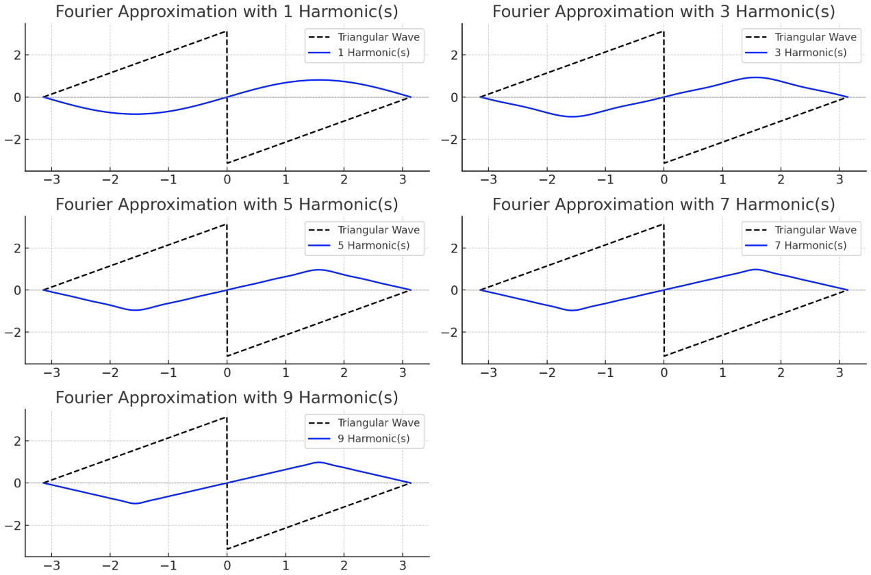
4) Examples (1): ODD FUNCTION WITH FOURIER SERIES
Triangular / Sawtooth Wave
These waves are commonly used in:
Electronics
Audio synthesis
Signal processing

Slide 46
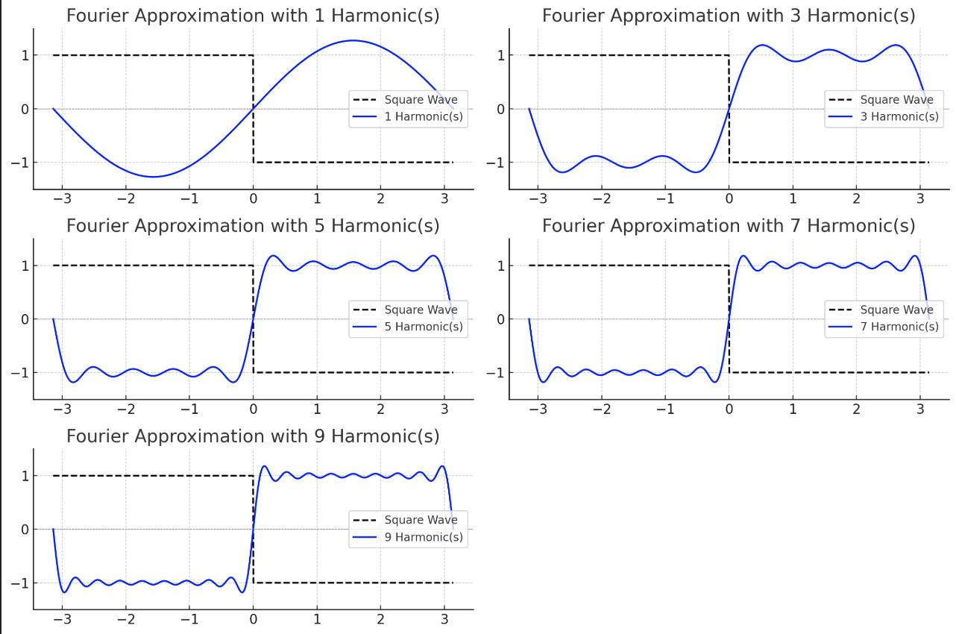
4) Examples (2): ODD FUNCTION WITH FOURIER SERIES
Square wave
These types of functions appear in:
Digital Electronics
Clock Signals
Music Synthesis
Control Systems

Slide 47
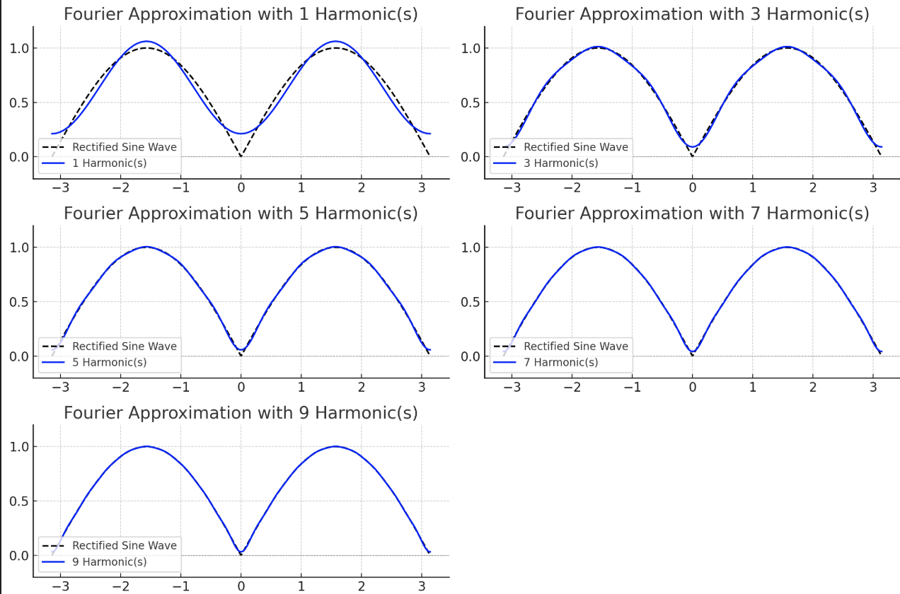
4) Examples (1): EVEN FUNCTION WITH FOURIER SERIES
Rectified sine wave
These types of functions appear in:
AC power systems
Signal Processing

Slide 48
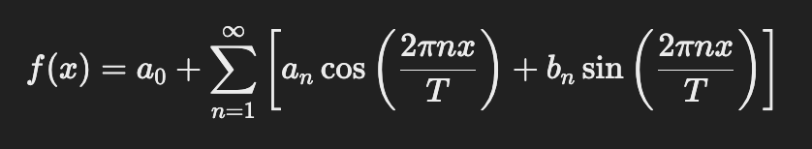
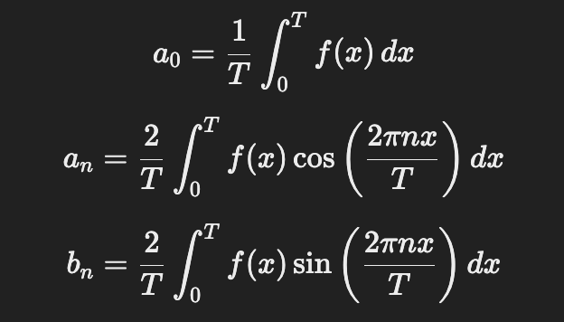
Numerical Example:

Slide 49

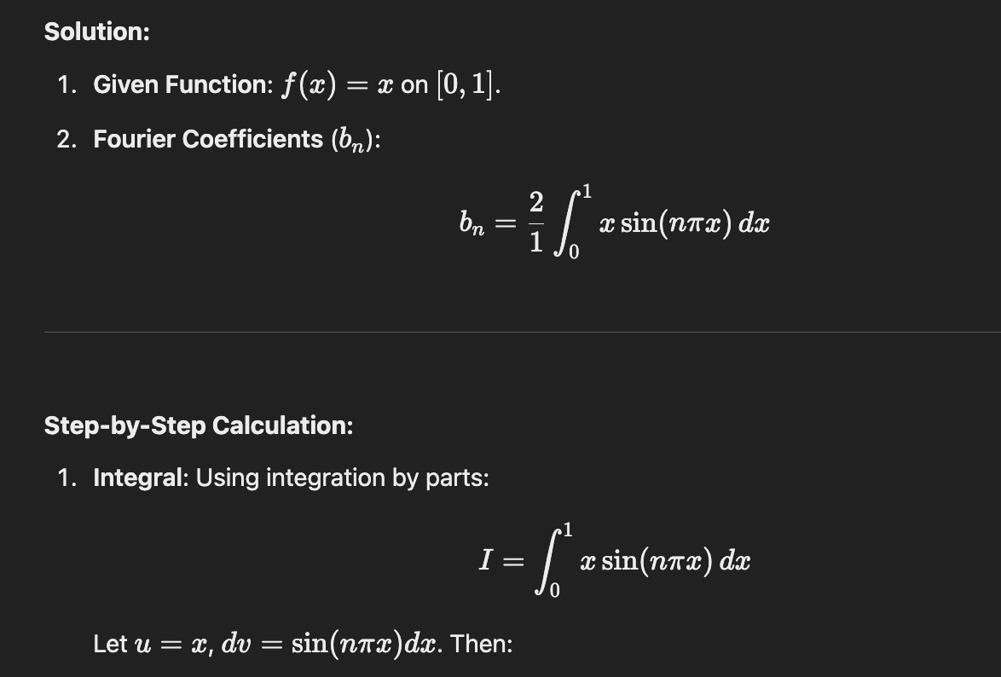

Slide 50
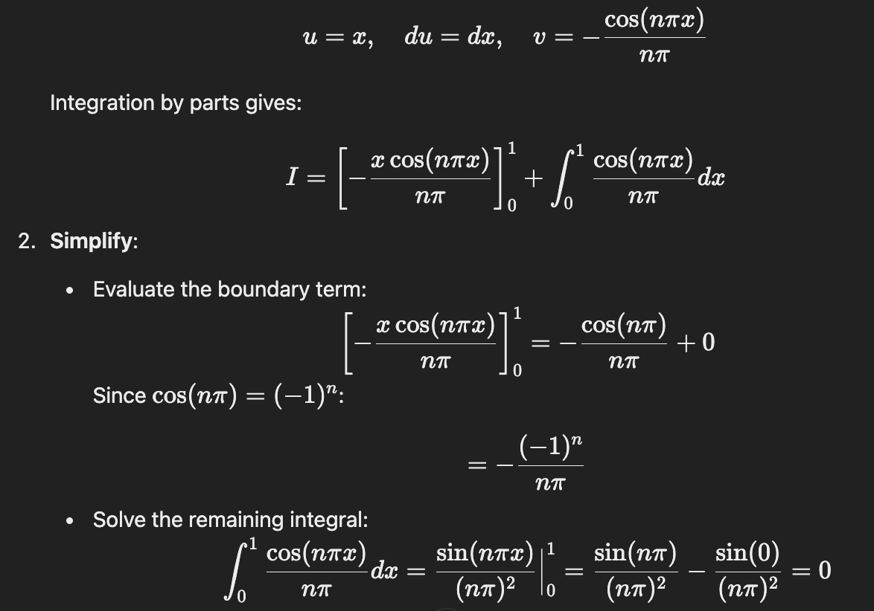

Slide 51
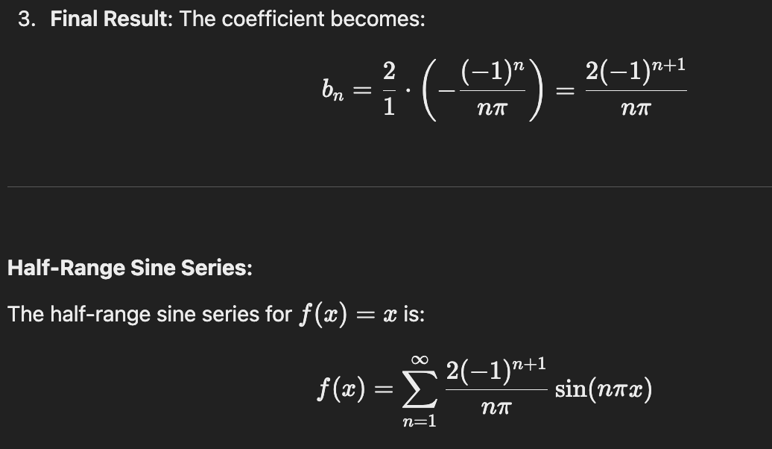

Slide 52
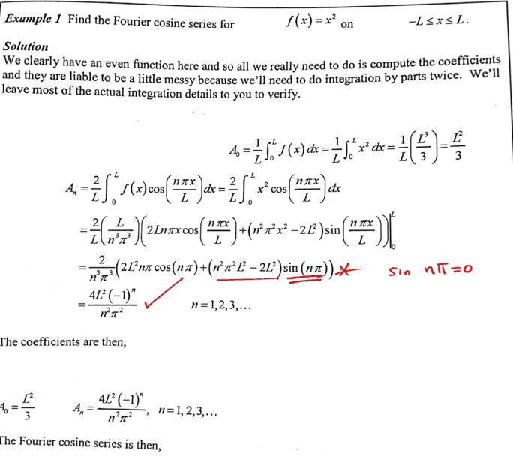

Slide 53
Conclusion
Abdul Muqeet Paracha ()

Slide 54
Key Points
Even functions are symmetric about the y-axis
Odd functions are symmetric about the origin
Fourier series is a mathematical tool used to represent a periodic function as a sum of sine and cosine functions
Complex periodic signals into simpler sinusoidal components.
Simplifying computations through symmetry.
Enable efficient and compact representation of functions.
Separating signals into meaningful components for analysis and applications.

Slide 55
Thank you!
Fee Free to ask any question.

